Slide 1
Automated PIN Cracking
Justin Engler Paul Vines

Slide 2
Agenda
Current PIN Cracking Methods
Cracking with Robots
R2B2
C3BO
Defeating the Robots

Slide 3
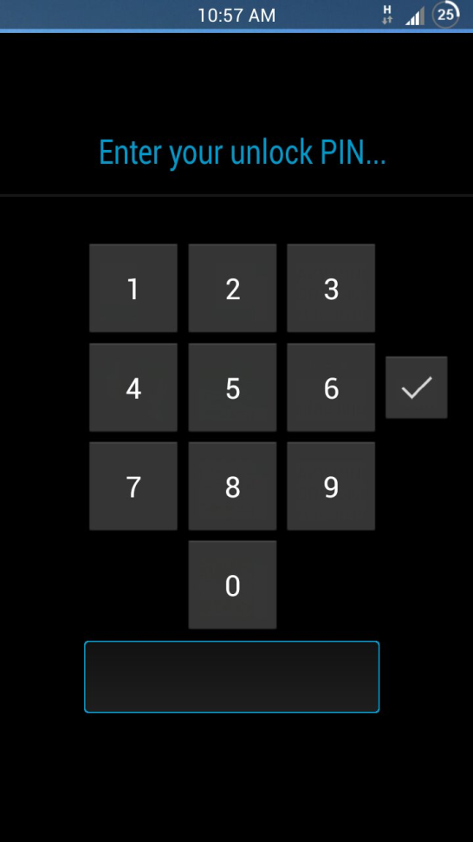
PINs
One of the most popular ways to lock mobile devices
Commonly still only 4-digit despite ability to be longer
User chosen, so typically low-entropy

Slide 4
PIN Cracking Now
Jailbreak and Crack
Keyboard Emulation
Punish an Intern

Slide 5
Jailbreak and Crack
Use jailbreaking/rooting exploits on the device
Bypass the lock screen with these new user capabilities
Problem: not all devices have known exploits for gaining root (and without wiping the device)

Slide 6
Keyboard Emulation
If the device supports a keyboard attachment
Make a device that emulates a keyboard and tries all the different PIN combinations automatically
Problem: not all devices support an external keyboard being added

Slide 7
Punish an Intern
Forcing your intern to try all 10,000 4-digit combinations will surely be more productive than anything else they could have been doing, except maybe getting coffee
Problem: Interns are universally bad at their jobs, so they might miss some of the combinations

Slide 8
PIN Cracking with Robots
Required Abilities:
“Push” buttons in sequence
Remember what buttons were pushed
Recognize success
Not always necessary

Slide 9
Robotic Reconfigurable Button Basher (R2B2)
Homemade Delta Robot body
Arduino Uno brain
Total cost: < $200

Slide 10
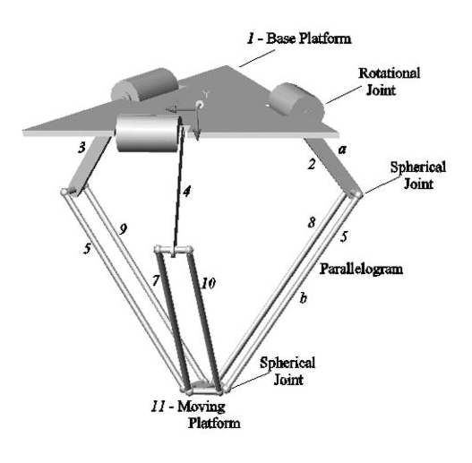
Delta Robot
*
Designed for fast precision industrial work
Simple combination of 3 single-motor arms gives precision 3D movement with somewhat small range of motion
Fairly simple motion control
* Lopez, Castillo, Garcia, and Bashir. Delta robot: inverse, direct, and intermediate Jacobians. Proc. IMechE Vol.220(2006)

Slide 11
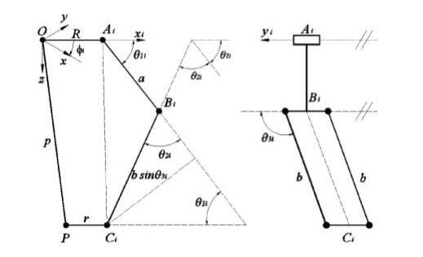
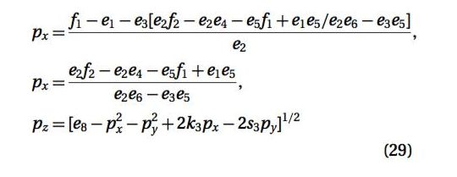
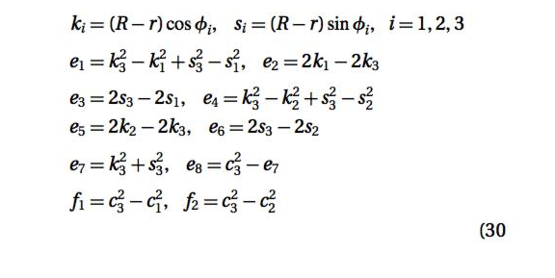
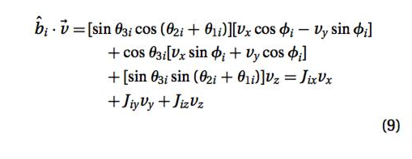
“Fairly Simple” Motion Control Still a lot of math…

Slide 12
So we found someone else’s code to do it

Slide 13
Arduino Uno
Standard robotic hobby microcontroller board
Open source code for controlling a delta robot by Dan Royer (marginallyclever.com)
Uses serial port communication to control the movement of the robot
Easy to tweak functionality for pressing buttons instead of manufacturing
Easy to control with a Python program

Slide 14
Modifications
The original delta robot kit was modified to have its tool be a touch-screen stylus tip for pressing buttons
A camera was added to allow easier user interface with the robot to set up the PIN cracking task
And recognize when the device is unlocked!
The motion control software was modified to speed up movement, up to 5 presses/second

Slide 15
Wrap Everything in Python
Controls the robot movement through the serial port
Performs image analysis of the camera feed
Provides a simple interface for the user to set the robot up for PIN cracking
Detects success of PIN cracking to stop robot and alert user

Slide 16
(a bit) Better than brute-forcing
Harvested 4-digit sequences from online password lists
(eharmony, myspace, etc.)
Presumably what Nick Berry did for his blog but wouldn’t share…
Combined with Daniel Amitay’s (danielamitay.com) phone app PIN list
And we get…

Slide 18
Challenges
Detecting button values:
Too tough to reliably do on all devices
User set up time is negligible for a 10-digit keypad
Recognizing delays:
Some devices have more easily recognized delay messages than others
If necessary, the user can manually input the delay pattern of a device (i.e. 30 seconds every 5 tries)

Slide 19
Real Buttons Too!
R2B2 can of course also be used for brute-force PIN cracking of physical buttons as well
Electronic keypads or completely mechanical keys, provided it can detect when it has succeeded

Slide 20
Capacitive Cartesian Coordinate Bruteforcing Overlay (C3BO)
Attach a grid of electrodes to the device’s virtual keyboard
Trigger electrodes via an Arduino to trick the device into thinking the screen was touched at that point
No mechanical motion = faster button pressing
More user configuration required to manually place the electrodes

Slide 21
C3BO continued
Cheaper than R2B2 ( ~ $50)
Nearly the same software for controlling/detecting device state changes with camera

Slide 22
Defeating the Robots
Forced delay timer after X attempts
On Android this is 30 seconds regardless of previous attempts
R2B2 would succeed in a worst case of ~20 hours
Likely success much sooner (80 mins =50%, 7 hrs =80%)
User Lockout after X attempts
On iOS, 1 minute lockout after 5 guesses
Lockout time quickly scales up for continued bad guesses (1 minute, 5 minutes, 15 minutes, 60 minutes)
Roughly 20% success rate on a 20 hour run

Slide 23
Are these robots useful, then?
Compared to R2B2:
Jailbreak + Bypass: Best if available
Keyboard Emulator: The fastest brute-forcing
C3BO: Usable on any capacitive touch keyboard, a bit slower and more setup required than a keyboard emulator
R2B2: Flexible and usable on basically any PIN protected device but slower and more cumbersome

Slide 24
Acknowledgments
Thanks to iSEC Partners and the NCC Group for supporting this research
Thanks to Dan Royer for providing the motion control code and robot build plans

